Slide 1
Inflation Reduction Act
The Impact on Prescription Drugs for 2025

Slide 2
Hello, I’m your local
Licensed Insurance Agent.
1
I am licensed, certified and trained to understand how Medicare works.
4
I must pass an annual AHIP exam, which covers the basics of Medicare, as well as Fraud, Abuse & Waste training.
2
Every year I spend 80+ hours obtaining certifications from many top carriers.
5
I am trained to use Medicare.gov to review prescription drugs and find you a plan to cover them within your budget.
3
Attorneys, nurses, CPAs, physicians, and real estate agents only complete an average of 20 educational hours per year.

Slide 3
Working With A Licensed Insurance Agent
My service and promise to you
KNOWLEDGEABLE AND PERSONALIZED
EDUCATION ON THE MEDICARE PLAN OPTIONS
NO-COST ANNUAL PLAN REVIEW
I WILL BE HERE ALL YEAR ROUND TO HELP YOU WITH ANY QUESTIONS, CONCERNS, AND PLAN ISSUES

Slide 4
AGENDA
Medicare Basics ABCD
Inflation Reduction Act
2025 Part D Improvements
The Impact on Medicare Coverage
What can you do?
Medicare Overview

Slide 5
The Medicare Basics

Slide 6
Original Medicare
1
2
Part A (Hospital Insurance)
Part B (Medical Insurance)
You have options for additional coverage:
3
4
5
and/or
OR
Medicare Supplement
Part D (Prescription Drug)
Part C
(Medicare Advantage)
May include Rx Plan

Slide 7
The Inflation Reduction Act

Slide 8
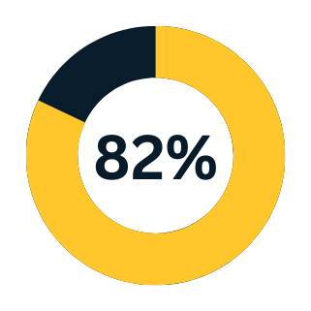
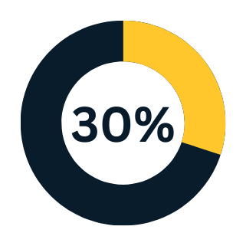
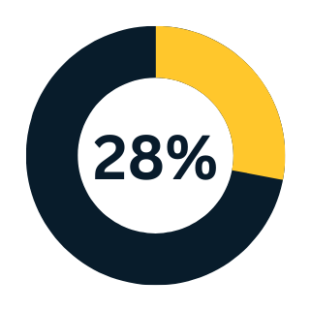
Concerns about the cost of prescription drugs
82% of adults think the cost of prescription drugs is unreasonable
About 30% of adults say in the last year, they have not taken prescription medicines as directed because of cost
28% of adults say it is very difficult for them to afford to pay for their prescription drugs
Source: KFF, “Public Opinion on Prescription Drugs and Their Prices,” April 2023.

Slide 9
Solution? The Inflation Reduction Act
Created to provide meaningful financial relief for Medicare beneficiaries, including improvements to Medicare.
Passed in 2022 to:
Increase access to treatments and expand services
Provide affordability by lowering Medicare costs and limiting price increases
Make the Medicare program more sustainable now and in the long-run

Slide 10
Key Changes for the Inflation Reduction Act
Part D Improvements
2023 - 2025
Medicare Drug Price Negotiation
2026 - 2027
Inflation Rebates in Medicare
2022 - 2025
Changes to Medicare Part B
2023

Slide 11
Key Changes for the Inflation Reduction Act
Part D Improvements
2023 - 2025
Medicare Drug Price Negotiation
2026 - 2027
Inflation Rebates in Medicare
2022 - 2025
Changes to Medicare Part B
2023

Slide 12
Part D Improvements Timeline
2023
2024
2025
Vaccines without copays
Insulin copays limited to $35/month
Eligibility expansion for “Extra Help” program
Elimination of 5% coinsurance in catastrophic phase
$2,000 annual cap on prescription drug costs
Monthly payment program for yearly out-of-pocket prescription drug costs
Part D Redesign (no more Coverage Gap phase)
Implementation of Manufacturer Discount Program

Slide 13
2025 Part D Improvements
Your out-of-pocket prescription drug costs is capped at $2,000 for the year.
You can enroll into the Medicare Prescription Payment Plan to help spread your out-of-pocket prescription costs over the year.

Slide 14
Medicare Prescription Payment Plan
Makes paying your out-of-pocket prescription drug costs more manageable by spreading the cost throughout the plan year.
Reminder: Out-of-pocket prescription drug costs capped at $2,000.
Once enrolled:
You’ll be charged $0 at the pharmacy counter.
Billing will come from your plan when you have out-of-pocket prescription drug costs.
Deductible must be paid first and copays may apply.
Monthly bill may fluctuate (based on your out-of-pocket cost incurred each month).
You can opt out any time - will need to pay what is owed.

Slide 15
Simplified
Example
Beneficiary enrolls in Medicare Prescription Payment plan in January 2025 (Cost sharing + OOP amounts shown)
Month | OOP Costs Incurred | Divide by | OOP Costs Incurred Split | Max Monthly Cap | Monthly Beneficiary Payment
January | $0.00 | 12 months | $166.67 | $166.67 | $0.00
February | $1,200.00 | 11 months | $109.09 | $109.09 | $109.09
March | $12.00 | 10 months | $1.20 | $110.29 | $110.29
April | $12.00 | 9 months | $1.33 | $111.62 | $111.62
May | $12.00 | 8 months | $1.50 | $113.13 | $113.13
June | $215.00 | 7 months | $30.71 | $143.84 | $143.84
July | $0.00 | 6 months | $0.00 | $143.84 | $143.84
August | $530.00 | 5 months | $106.00 | $249.84 | $249.84
September | $12.00 | 4 months | $3.00 | $252.84 | $252.84
October | $7.00 | 3 months | $2.33 | $255.17 | $255.17
November | $0.00 | 2 months | $0.00 | $255.17 | $255.17
December | $0.00 | 1 month | $0.00 | $255.17 | $255.17
TOTAL: | $2,000 |  |  |  | $2,000
Source: Johnson, Ann; Pharmacy Healthcare Solutions, Medicare Prescription Payment Plan …aka OOP Price Smoothing. Published in Feb 2024. https://phslrx.com/wp-content/uploads/2024/02/ASAP2024_Presentations_08_Ann-Johnson-Medicare-Payments-and-Beneficiary-Smoothing-What-Pharmacies-Need-to-Know.pdf

Slide 16
2025 Part D Improvements
Part D Redesign Program will consist of three phases:
Phase 1
Annual Deductible
Phase 2
Initial
Coverage
Coverage Gap
(Donut Hole)
Phase 3
Catastrophic Coverage
The amount you pay before a plan covers your prescription drug costs.
The plan pays its share of the cost, and you pay your share (copays and coinsurance).
The plan is limited in how much it can pay for your drugs. You will pay 25% of the costs for covered drugs.
After you reach the MOOP, the plan will pay your drug costs for the rest of the year.
Deductible Range:
$0 - $590
Your Maximum Out-of-Pocket Rx Drug Costs (copays and coinsurance):
$2,000
No copay or coinsurance.
The Coverage Gap Phase will be end on December 31, 2024, and be replaced with the Manufacturer Discount Program.

Slide 17
Manufacturer Discount Program
How is it applied to the Part D program?
Phase 1
Annual Deductible
Phase 2
Initial
Coverage
Coverage Gap
(Donut Hole)
Phase 3
Catastrophic Coverage
Not applicable on deductible.
Manufacturers will provide a 10% “discount” as their cost-share on applicable brand-name drugs.
Manufacturers will provide a 20% “discount” as their cost-share on applicable brand-name drugs.
Participating manufacturers must enter into an agreement with CMS (Centers for Medicare & Medicaid Services) for Part D coverage eligibility and offer a discount on applicable brand-name drugs.

Slide 18
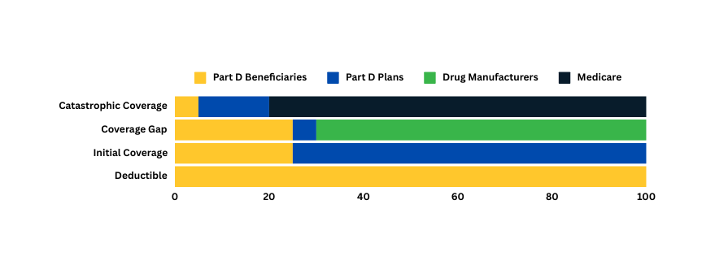
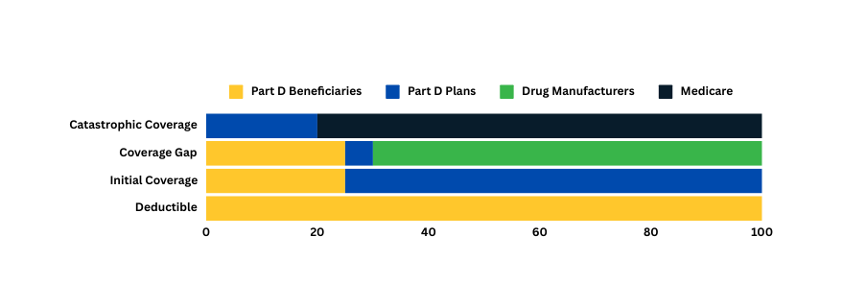
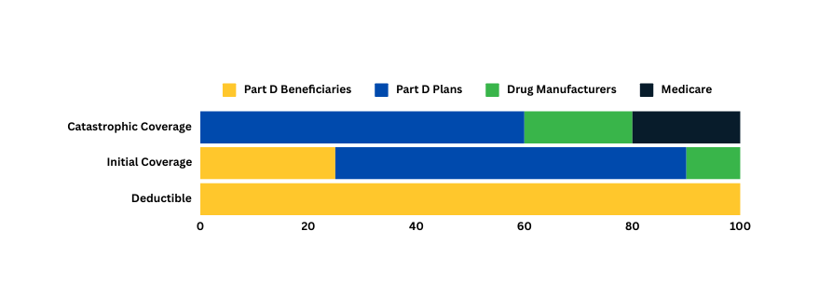
Share of Part D Drug Costs from 2023 - 2025
For Brand-Name Drugs
2023
OOP Spend Threshold:
~$3,100
5%
15%
80%
25%
5%
70%
25%
75%
100%
2024
OOP Spend Threshold:
~$3,250
20%
80%
25%
5%
70%
25%
75%
100%
2025
OOP Spend Threshold:
$2,000
60%
20%
20%
25%
65%
10%
100%
Source: KFF, based on Medicare Part D benefit design changes in the Inflation Reduction Act

Slide 19
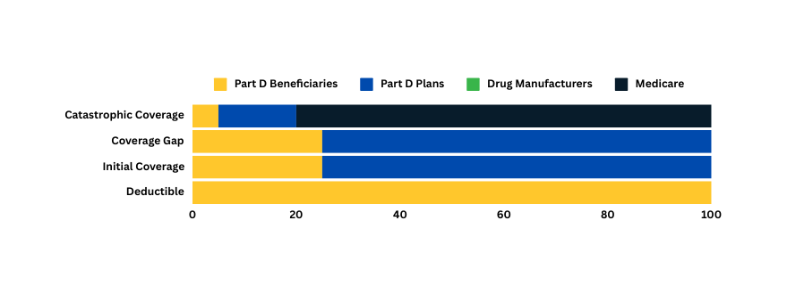
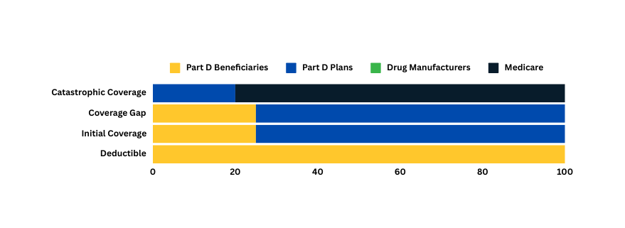
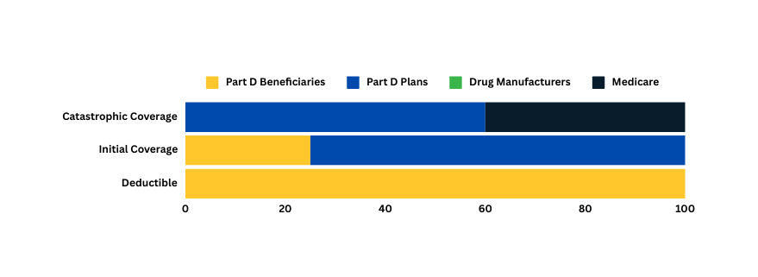
Share of Part D Drug Costs from 2023 - 2025
Generic Drugs
2023
OOP Spend Threshold:
~$3,100
5%
15%
80%
25%
75%
25%
75%
100%
2024
OOP Spend Threshold:
~$3,250
20%
80%
25%
75%
25%
75%
100%
2025
OOP Spend Threshold:
$2,000
60%
40%
25%
75%
100%

Slide 20
Key Changes for the Inflation Reduction Act
Part D Improvements
2023 - 2025
Medicare Drug Price Negotiation
2026 - 2027
Inflation Rebates in Medicare
2022 - 2025
Changes to Medicare Part B
2023

Slide 21
Changes to Medicare Part B
Improve access to high quality, affordable biosimilars (drug made from natural resources
Impose a $35/month cost-sharing cap on insulin used in durable medical equipment pumps (effective 2023)
Inflation Rebates in Medicare
Drug companies must pay Medicare a rebate if they increase prices for specific drugs faster than inflation.
Calculated and invoiced by CMS (begins fall 2025).
Ensures long-term sustainability of the Medicare program.
Medicare Drug Price Negotiations
Dedicated to improve access to some of the costliest single-source brand-name Medicare Part B and Part D drugs.
Starts in 2026 on ten (10) selected drugs.
Rebates from the selected drugs may change.
Additional drugs will be selected for negotiation every year after 2025.

Slide 22
The Impact on
Your Medicare Coverage

Slide 23
What can be expected with the upcoming 2025 changes to Part D
Your max out-of-pocket prescription drug cost is lower and capped at $2,000.
Monthly payment plans allow you to reduce the stress of financial insecurity.
You can access brand-name drugs that may have been too costly for you to pay out-of-pocket.
The discount and rebate programs go into effect on manufacturers that plan to increase prices, beating inflation.

Slide 24
What to be aware of with the upcoming 2025 changes to Part D
Medicare Prescription Payment Plan is more beneficial in the beginning of the year to spread out costs.
Those who are eligible for the “Extra Help” (Low-Income Subsidy)”, enrollment in “Extra Help” is more advantageous than the Medicare Prescription Payment Plan (payment plan still available to all beneficiaries).
Plans are required to do outreach of the payment program if you have been paying more than the 2025 annual cap, $2,000, between January 1, 2024 and September 30, 2024.
Drugs that are excluded from Medicare Prescription Payment Plan:
Non-covered drugs
Part B drugs

Slide 25
What to be aware of with the upcoming 2025 changes to Part D
The $2,000 cap does not apply to out-of-pocket spending on Part B drugs.
Once you incur a Part D out-of-pocket cost, the payment plan will apply to all of your covered Part D drugs and billed monthly.
You will not be able to pick and choose which covered prescriptions to include.
Part D plans will continue to bill any amounts owed (not to exceed the max monthly cap) for those who switch Part D plans or cancel participation.
Part D plans may choose to not cover certain drugs.
Notice any applicable changes and get assistance from your doctor about alternatives.

Slide 26
What to be aware of with the upcoming 2025 changes to Part D
The new law has prevented Part D base beneficiary premiums from increasing more than six percent each year (until 2030).
Does not limit other factors plans may add to plan costs.
Plan sponsor liability will increase in the catastrophic phase.
May see an increase in plan cost while you have lower out-of-pocket drug costs.
May see a reduction in plan services.
The definition of “creditable coverage” for prescription drug plans has been redefined.
Plan sponsors or plans may exit the Medicare market if they are unable to meet the new standards of creditable coverage.

Slide 27
What can you do?

Slide 28
Your healthcare needs are your priority for 2025. You deserve the right care with the right Medicare plan that suits your needs.
Review your current plan and keep a list of your current medications.
When your plan provides your yearly notice in September, pay close attention to any changes that may have been applied.

Slide 29
Stay updated on the new law
Visit www.cms.gov/inflation-reduction-act-and-medicare

Slide 30
Other resources
www.Medicare.gov or 1-800-MEDICARE (1-800-623-4227)
National Council on Aging: www.ncoa.org
State Health Insurance Assistance Program: www.shiphelp.org

Slide 31
Sources Cited
Centers for Medicare & Medicaid. “Inflation Reduction Act and Medicare.”
https://www.cms.gov/inflation-reduction-act-and-medicare
PAN Foundation. “Everything you need to know about Medicare reforms.”
https://www.panfoundation.org/everything-you-need-to-know-about-medicare-reforms
KFF. “Public Opinion on Prescription Drugs and Their Prices.” April 2023.
https://www.kff.org/health-costs/poll-finding/public-opinion-on-prescription-drugs-and-their-prices/
KFF. “FAQs about the Inflation Reduction Act’s Medicare Drug Price Negotiation Program.” January 2024. https://www.kff.org/medicare/issue-brief/faqs-about-the-inflation-reduction-acts-medicare-drug-price-negotiation-program/
KFF. “Changes to Medicare Part D in 2024 and 2025 Under the Inflation Reduction Act and How Enrollees Will Benefit.” April 2023. https://www.kff.org/medicare/issue-brief/changes-to-medicare-part-d-in-2024-and-2025-under-the-inflation-reduction-act-and-how-enrollees-will-benefit/
OneDigital. “How will the Inflation Reduction Act (IRA) of 2022 Impact Employer-Sponsored Group Health Plans in 2025?” March 2024. https://www.onedigital.com/blog/ira-impact-group-health-plans-2025/
Millman. “Impact of the Inflation Reduction Act on plans seeking creditable coverage” April 2024. https://www.milliman.com/en/insight/impact-inflation-reduction-act-plans-seeking-creditable-coverage
Independence Blue Cross. “How the Inflation Reduction Act Affects Medicare Members.” April 2024. https://insights.ibx.com/how-the-inflation-reduction-act-affects-medicare-members/
Cap 20. “Project 2025 Prescription Drug Plan Would Increase Costs for as Many as 18.5 Million Seniors and Others With Medicare.” June 2024. https://www.americanprogress.org/article/project-2025-prescription-drug-plan-would-increase-costs-for-as-many-as-18-5-million-seniors-and-others-with-medicare/
Innovare Corporation. “Understanding the 2025 Medicare Part D Re-design: What You Need to Know.” April 2024. https://www.linkedin.com/pulse/understanding-2025-medicare-part-d-re-design-what-yrt6c/
Johnson, Ann; “Pharmacy Healthcare Solutions, Medicare Prescription Payment Plan …aka OOP Price Smoothing.” Feb 2024. https://phslrx.com/wp-content/uploads/2024/02/ASAP2024_Presentations_08_Ann-Johnson-Medicare-Payments-and-Beneficiary-Smoothing-What-Pharmacies-Need-to-Know.pdf

Slide 32
Healthcare changes can be overwhelming.
Peace of mind is my goal for you, and I’m here to help simplify the process.

Slide 33
Medicare Overview (2024)
Part A - Hospital Insurance
Cost: $0 - $505 (based on number of quarters worked)
$1,632 deductible per service period; days 1–60 $0, days 61–90; $408 copayment per day, days 91+; $816 copayment per day.
Skilled nursing facility, no cost for days 1–20, $204 copayment per day for days 21–100, all costs for all days after 100.
Part B - Medical Insurance
Cost: $174.70/month or higher depending on income
$240 annual deductible
After deductible is met, you typically pay 20% of the Medicare-approved amount for most doctor services.
Part C - Medicare Advantage
Medicare Advantage Plans are an alternative option to coordinated care, that covers Parts A and B and may include Part D (Prescription Drug plans).
Costs vary depending on plan choice.

Slide 34
Medicare Overview (2024)
Part D - Prescription Drug Plans
Costs vary depending on plan choice.
$545 annual deductible
Initial Coverage limit is $5,030 and TROOP is $8,000
Catastrophic coverage assures you’ll pay nothing for your covered Part D drugs for the rest of the calendar year.
Medicare Supplement (Medigap)
Medicare Supplement, also called Medigap, helps pay for costs Original Medicare does not cover like copayments, coinsurance, and deductibles.
Does not offer prescription drug coverage. You pay a monthly cost in addition to Part B and Part D costs.

Slide 35
Your Medicare Options Review
1
2
3
4
EMPLOYER
GROUP PLAN
May have higher copay, deductibles, and coinsurance
ORIGINAL MEDICARE
80/20 Split
MEDICARE
ADVANTAGE
HMO Plans Managed care,
copays, networks
MEDICARE
ADVANTAGE
PPO Plans
Monthly costs, copays in and out of networks
MEDICARE
SUPPLEMENT
with stand-alone PRESCRIPTION DRUG PLAN
Monthly costs, any provider that accepts Medicare
or

Slide 36
Working With Me, A Licensed Insurance Agent
My service and promise to you
KNOWLEDGEABLE AND PERSONALIZED
EDUCATION ON THE MEDICARE PLAN OPTIONS
NO-COST ANNUAL PLAN REVIEW
I WILL BE HERE ALL YEAR ROUND TO HELP YOU WITH ANY QUESTIONS, CONCERNS, AND PLAN ISSUES

Slide 37
I understand everyone has different health and budgetary needs and one plan does not fit all.
We’ll work together to find the plan that best fits your needs.

Slide 38
I am here to help you at no cost or obligation to you!
My contact information:
Agent Name
Phone Number
License #
Email
By calling the number above, you will be directed to a licensed insurance agent.

