Slide 1
Medicare 101

Slide 2
Who is eligible for Medicare?

Slide 4
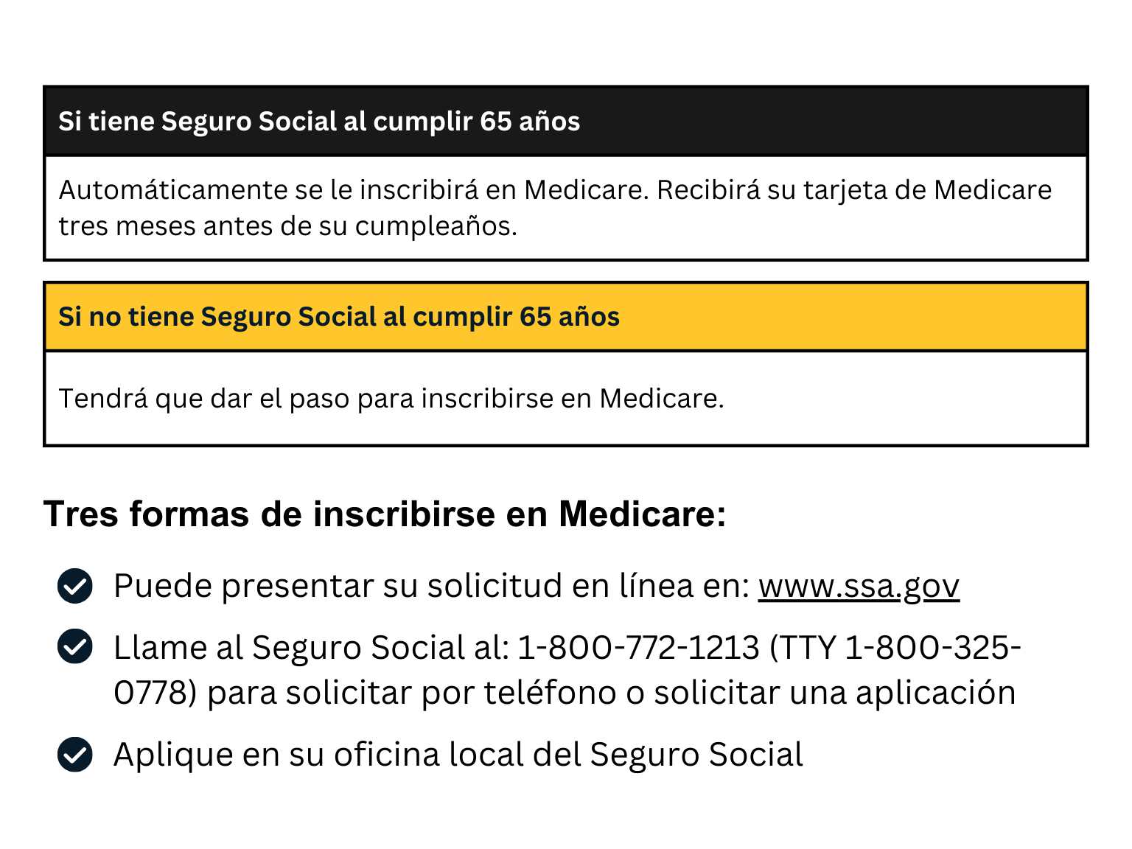

Slide 5
Medicare Basics

Slide 6
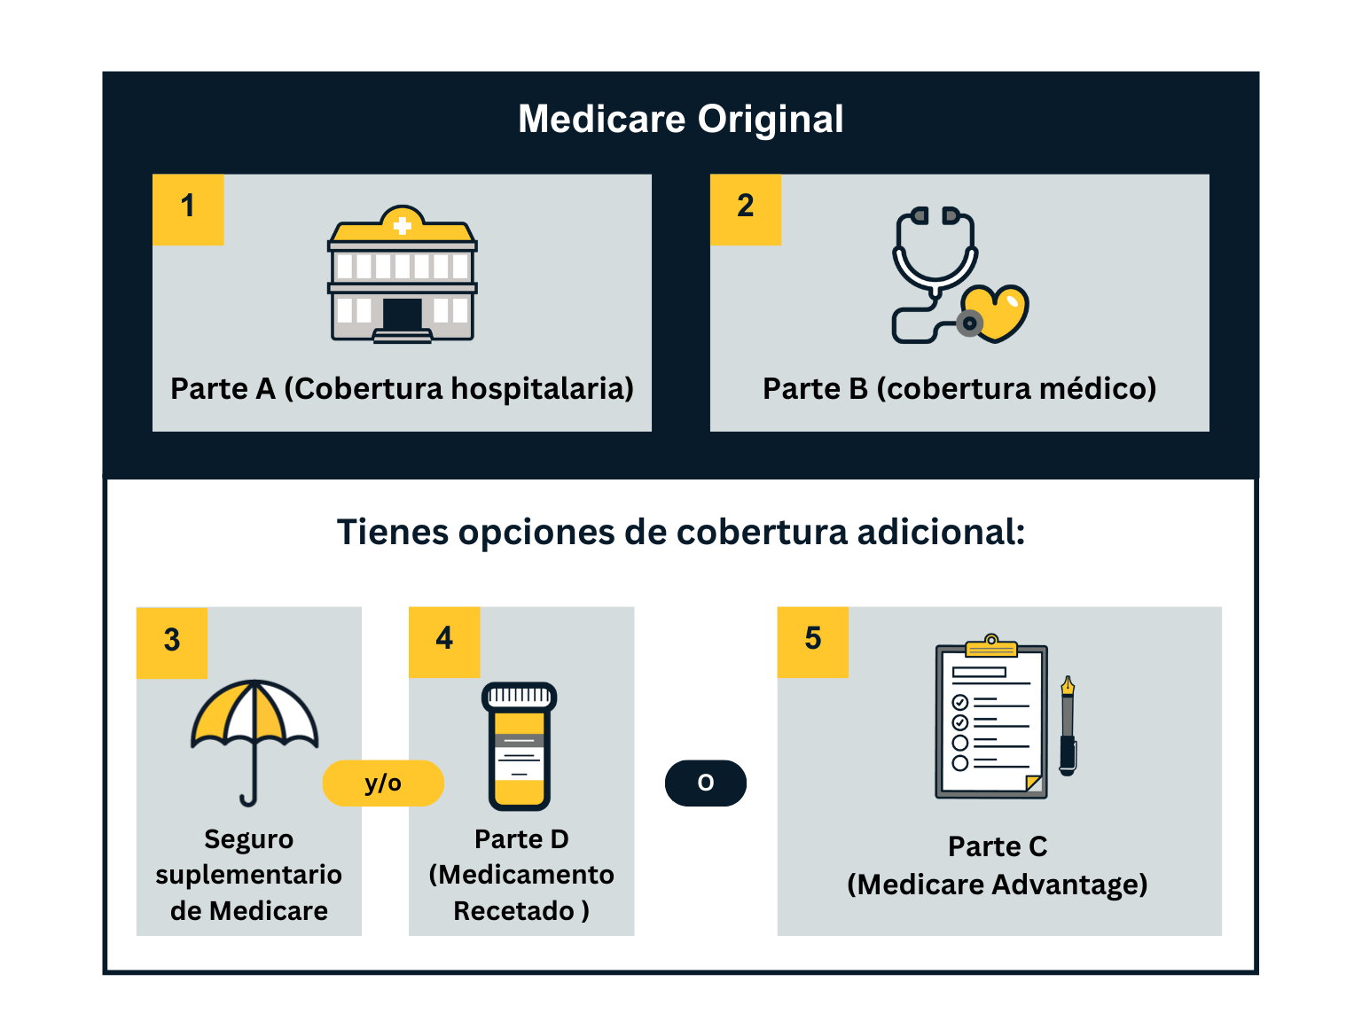

Slide 18
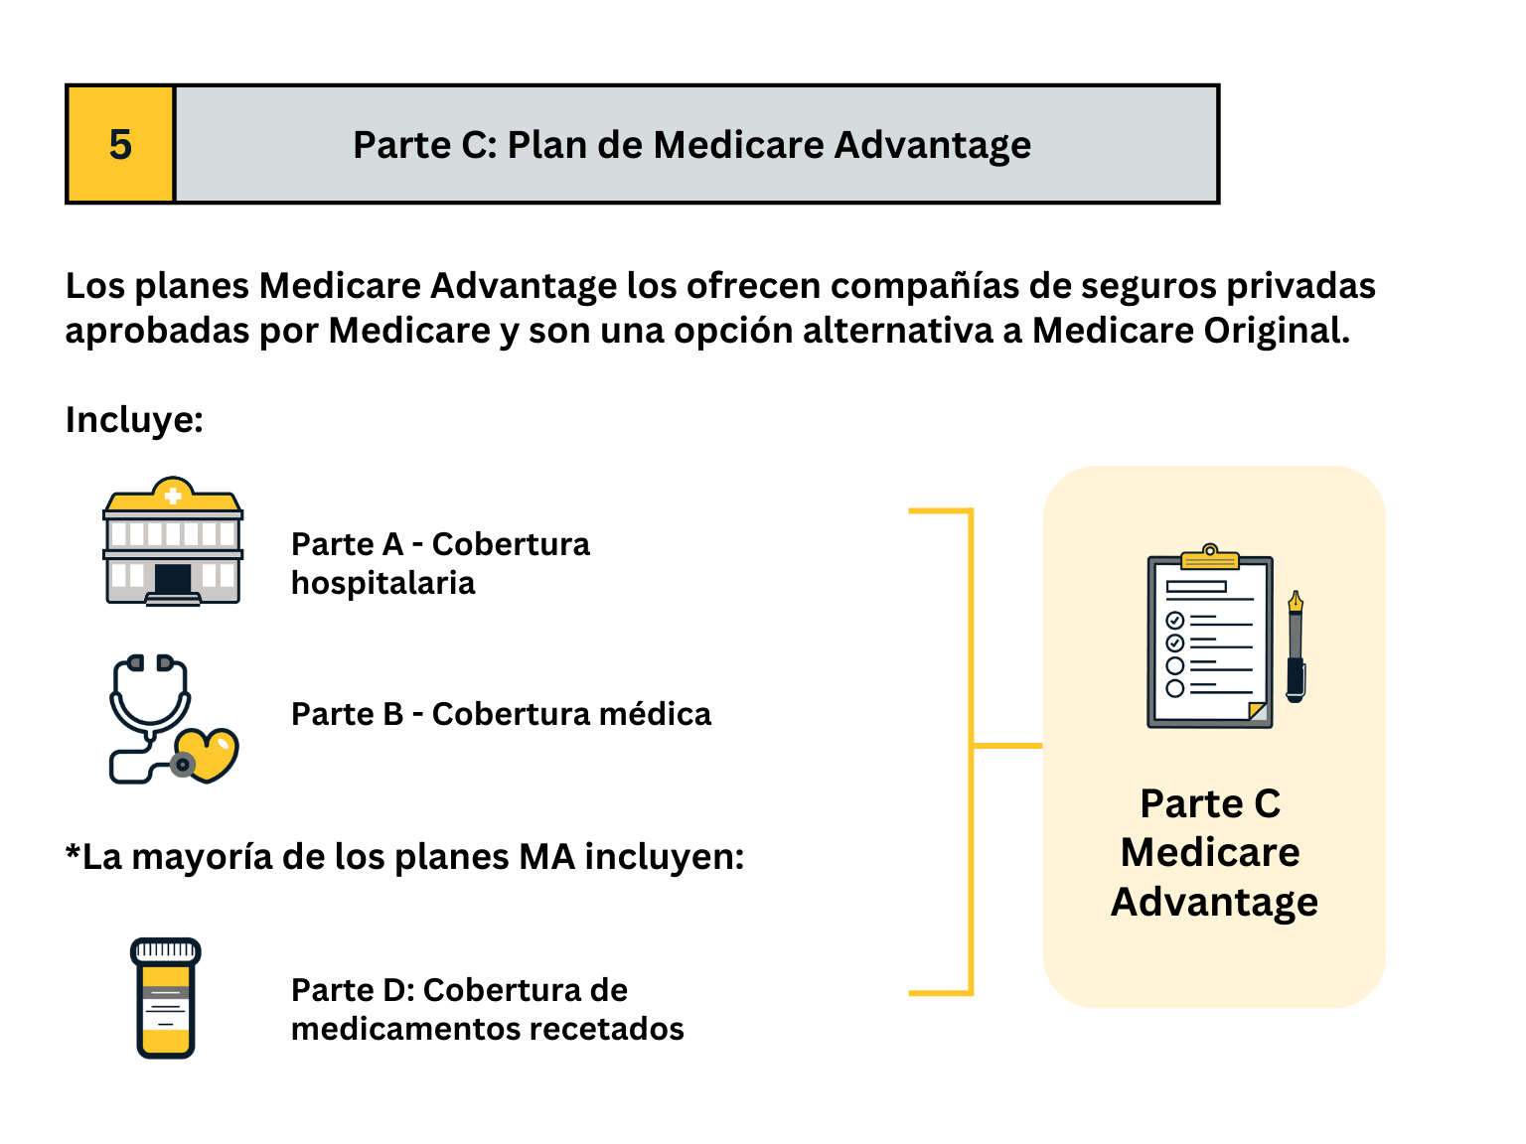

Slide 19
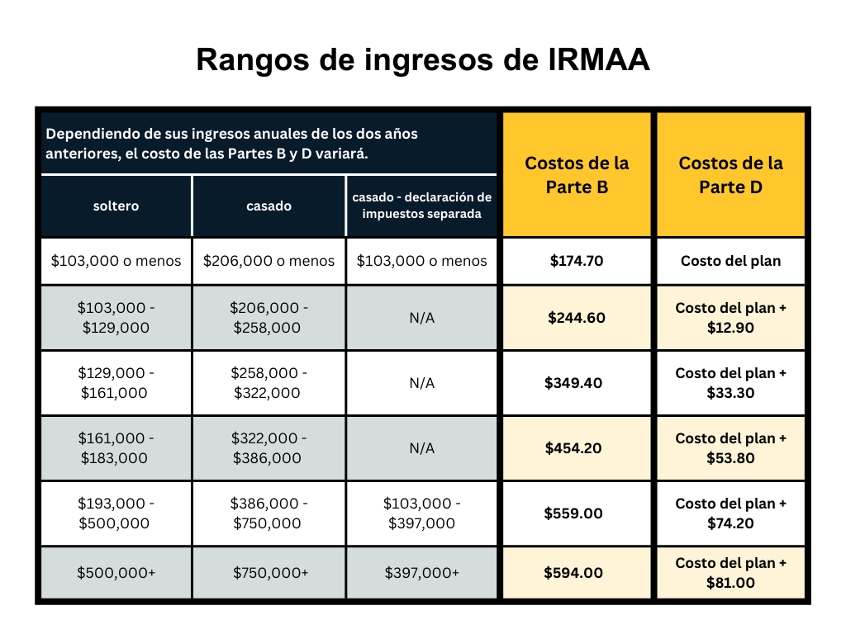

Slide 22
Enrollment Periods

Slide 29
Agent Name
Phone Number
License #
Email/Website

